Slide 1
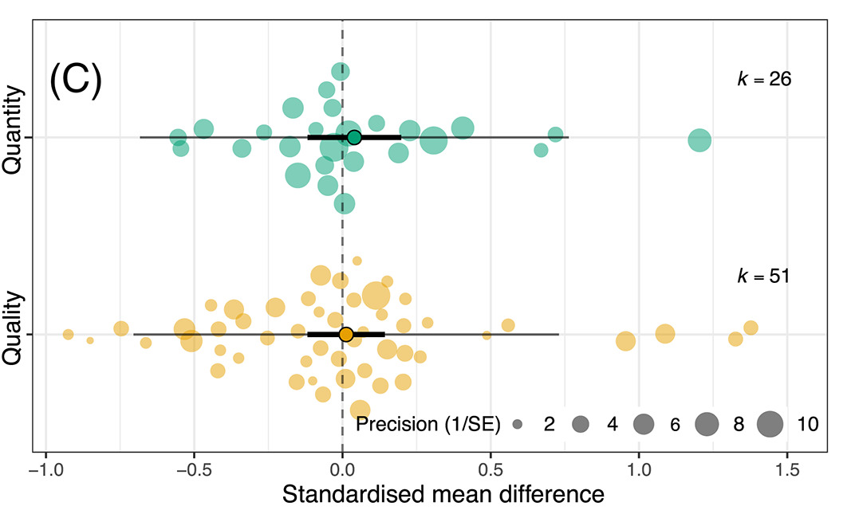
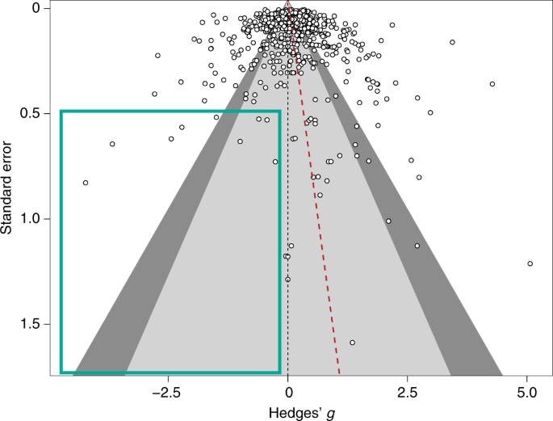
Meta-analysis in Comparative Physiology: A brief introduction to effect sizes and meta-analytic modelling
Nakagawa et al. 2021
De Boer et al. 2021
Daniel Noble, Nicholas Wu, Essie Rodgers, Patrice Pottier

Slide 2



Acknowledgements
Julia Koricheva
Wolfgang Viechtbauer
Shinichi Nakagawa

Slide 3
Workshop Overview
Part 1: 9:00 – 10:30
What is meta-analysis and why should we use it?
Effect size and sampling variance: the key data for meta-analysis
What are effect sizes?
What types are out there and when to use?
Standardizing effect estimates – nuisance heterogeneity
Interpreting effect sizes and transformations
Assumptions, limitations, and common challenges
Part 2: 11:00 – 12:30
Meta-analytic modelling
Fixed and random effect meta-analyses
Multi-level meta-analytic models (MLMA): The main types in comparative physiology
Non-independence – phylogeny, study, species, shared controls
Sensitivity analyses
Meta-regression and heterogeneity
Interpreting and reporting meta-analytic model output
Publication bias
Time-lag, reporting bias
Detecting and correcting
Part 3: 14:45 – 16:00
Help (advice) with your own meta-analysis! (if you need it)

Slide 4
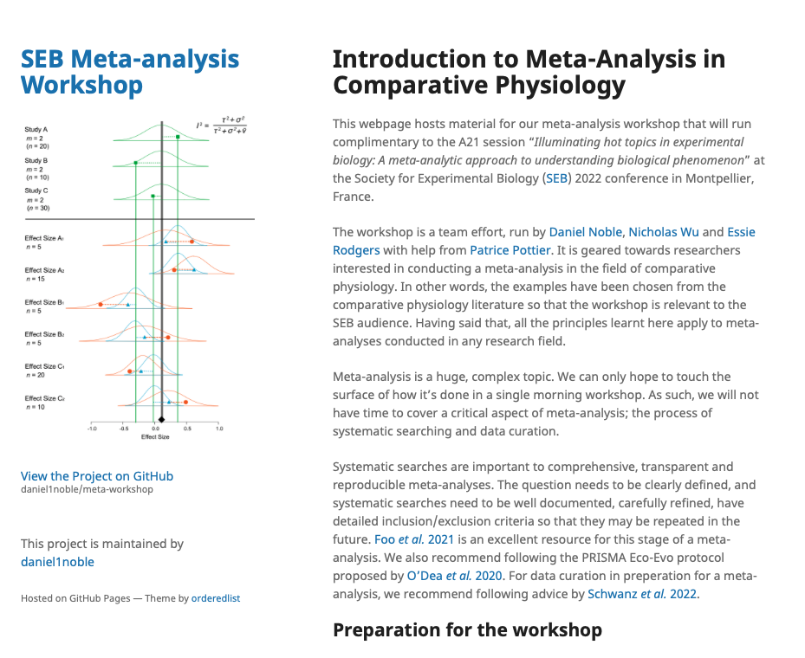
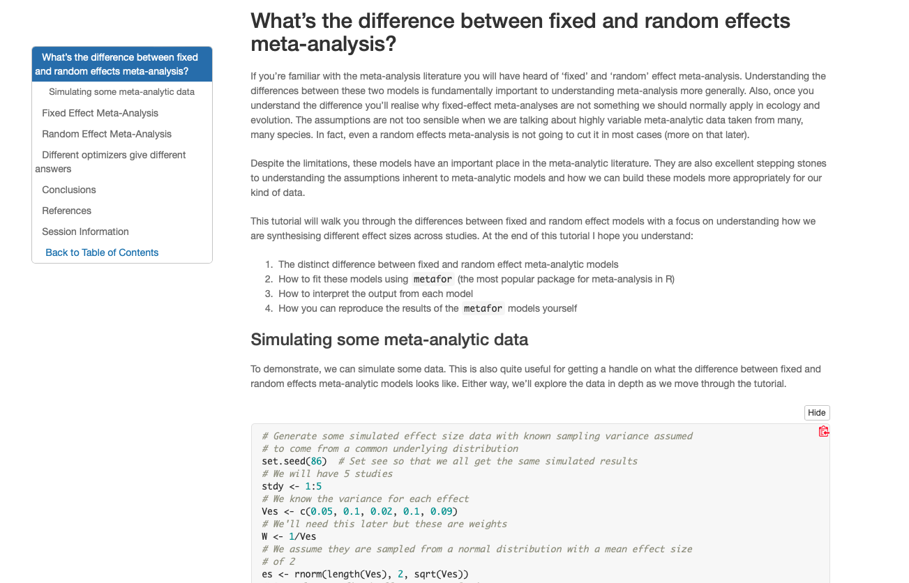
We have a webpage!
https://daniel1noble.github.io/meta-workshop/

Slide 5


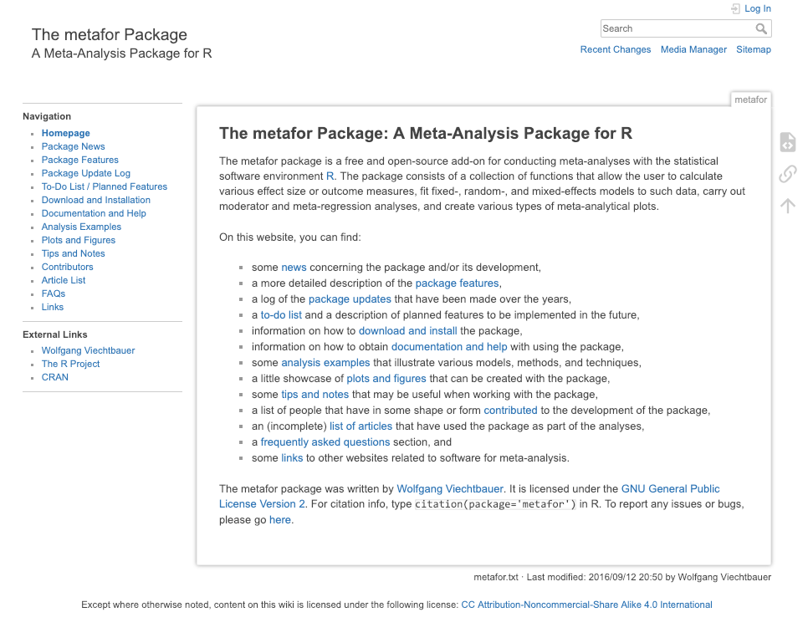
What we’ll use to code and analyze

Slide 6
https://wviechtb.github.io/metafor/articles/pkgdown/diagram.png

Slide 7
What you want to get out of this?
Thanks for taking the survey!
Here’s what everyone wants

Slide 8
What is a meta-analysis?

Slide 9
Why do we want to do meta-analysis?
Meta-analysis increases power and precision to estimate effects
Individual studies are (often) underpowered (Jennions & Møller, 2003)
High sampling variability can exaggerate effects; don’t put too much faith in a single study.
Establishes generalities
Explores differences between study and why they exist
Generates new hypotheses
Helps settle controversies from conflicting empirical studies
Can identify potential publication biases
Identify knowledge gaps to provide guidance for future empirical studies

